Slide 1
Architecture of Vanilla Transformer(Encoder)
Presented By:
Mahshar Yahan
BSc in Computer Science and Engineering
Chittagong University of Engineering and Technology

Slide 2
Content
What is Transformer
Application of Transformer
Basic Architecture of Transformer
Tokenization
Embedding
Positional Encoding
Self Attention
Multi Head Attention
Layer Normalization
Final Stage
Conclusion

Slide 3

What is Transformer?
Introduced by P. Vaswani in 2007
Revolutionized Natural Language Processing (NLP)
Uses attention mechanism
Over powers RNN, LSTM and Bi-LSTM

Slide 4
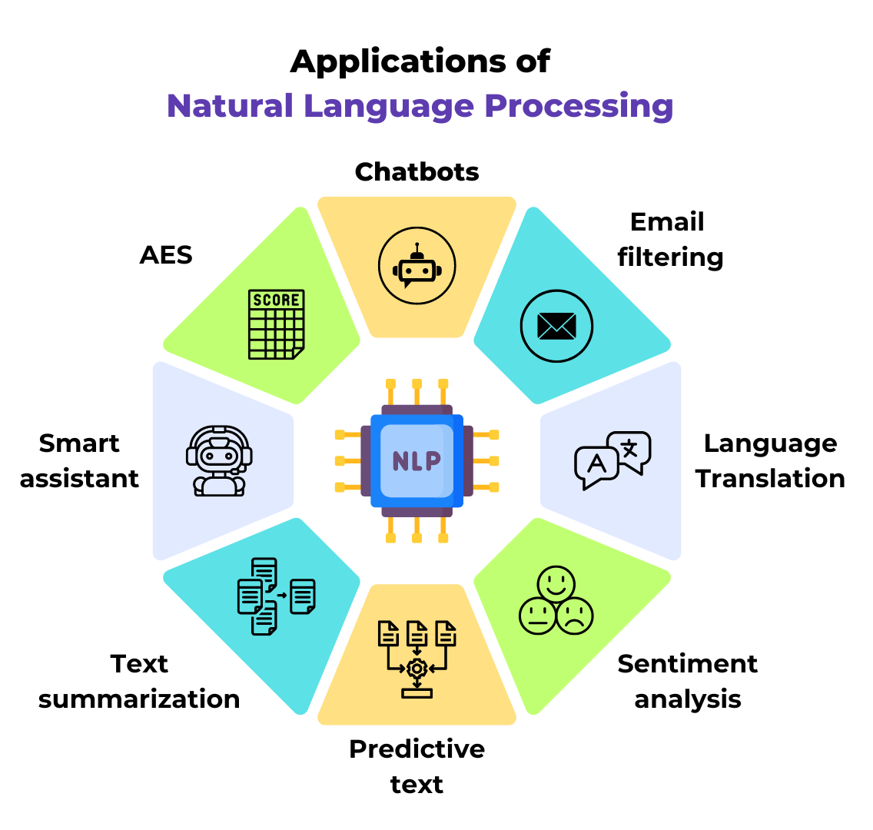
Application of Transformer
Question Answering
Sentiment Analysis
Summarization
Translation

Slide 5
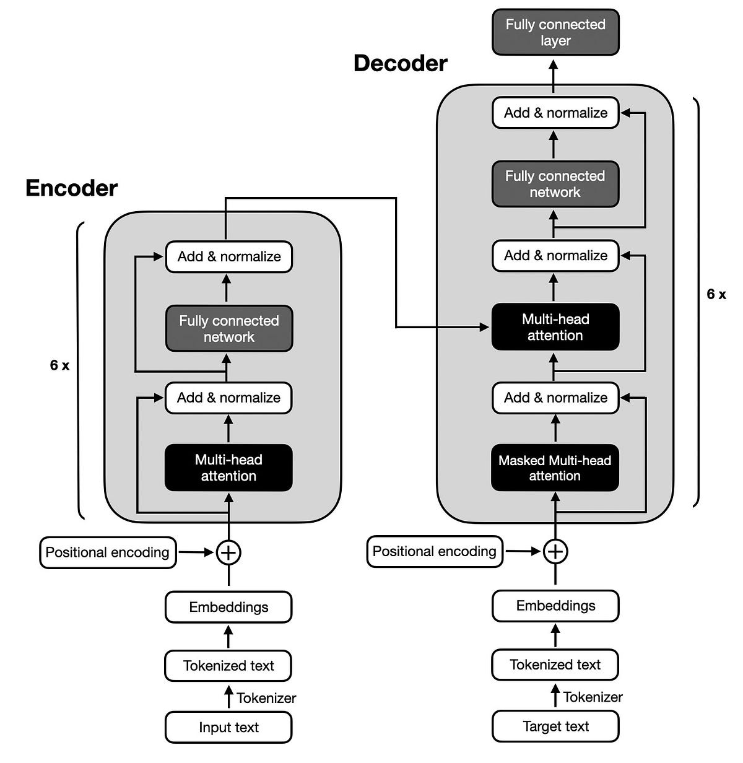
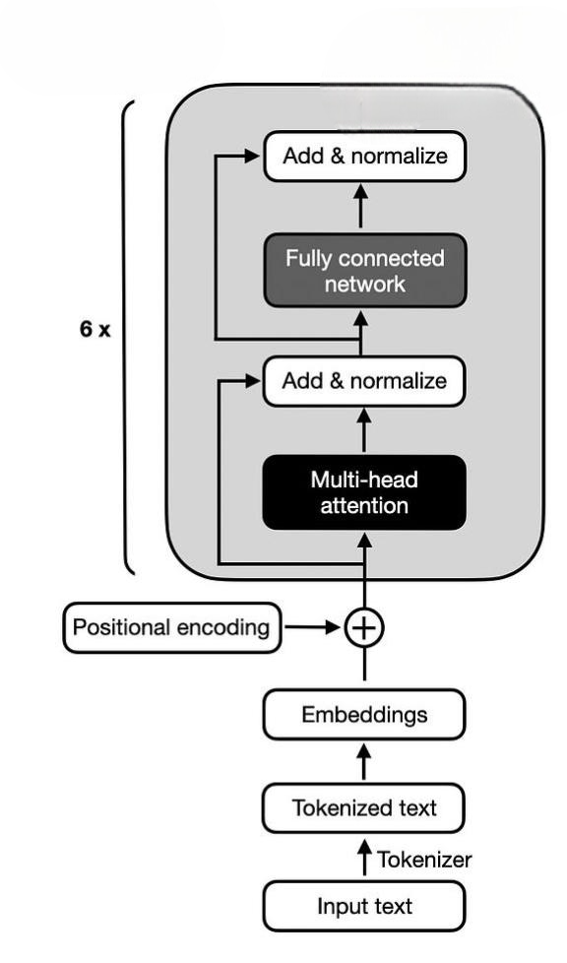
Basic Architecture for Transformer

Slide 6




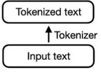
Tokenization
Tokenizer: Converts words in Input IDs and give attention mask
Special Token
CLS = Classification, sentence start
SEP = Sentence boundary
PAD = Padding
MASK= Masked token
Corpus
apple = 112
your = 105
cat = 6587
a = 3278
Rice = 212
Now we have completed……

Slide 7
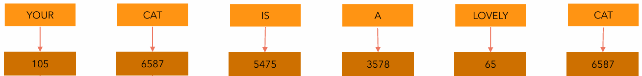
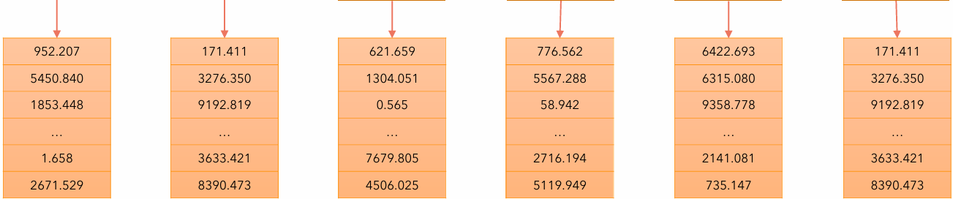
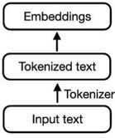
Embedding Layer
Embedding: Input IDs to vector representation
Original Sentence
Input IDs (Remove Special Token)
Transfer Each word to vector of size = 512(d_model)
Uses a lookup table to transfer word to 512 size vector.
Now we have completed

Slide 8
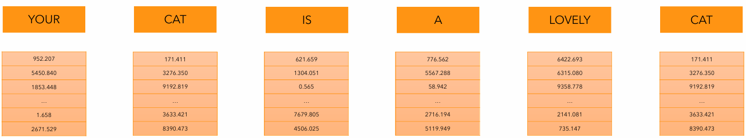
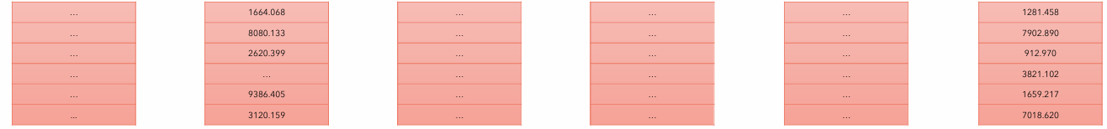
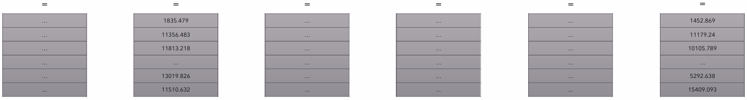
Positional Encoding(PE)
Positional Encoding: Each word to carry some information about its position in the sentence
Original Sentence
Input Embedding
Size = [1,512] each
Positional Embedding
Size = [1,512] each
Computed only once
Encoder Input
[6,512]

Slide 9
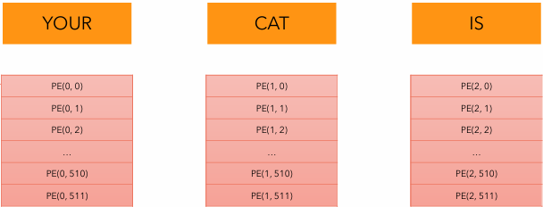
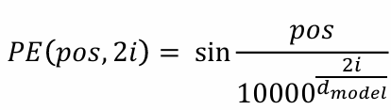
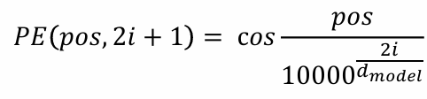
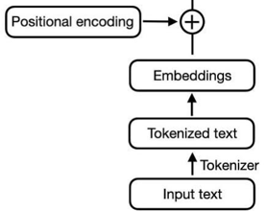
Positional Encoding
Now we have completed……
We have used sin and cos for their continuous property

Slide 10
Self Attention
Allows the model to relate words to each other
For example, Your cat is a lovely cat.
Query(Q): Looking for relevant information. Ex: Q = Lovely
Key(K): Reference items to find relevance. Ex: K = Cat, Your
Value(V): Key matches the Query. Ex: Cat (high relevance scores)

Slide 11
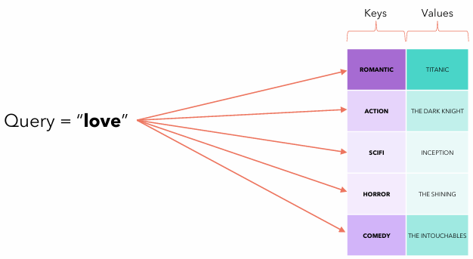
Self Attention(Cont..)
But in real dataset Q, K and V is a little different.
Vector Dot Product: Done by multiplication of two vector, result is scaler
Significance Of Dot Product: Represents degree two vectors align with each other.

Slide 12

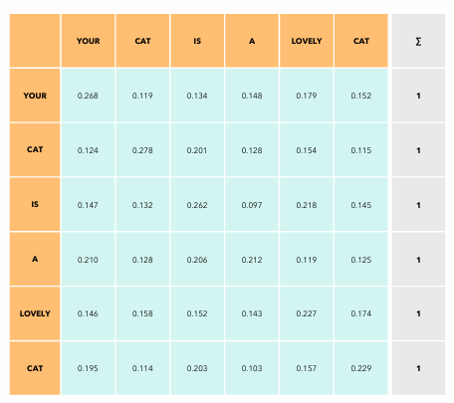
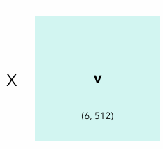
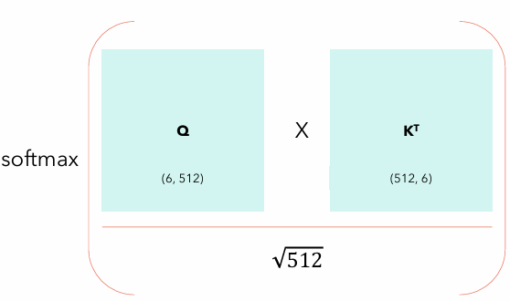
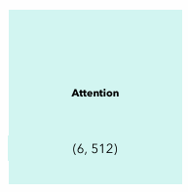
Self Attention(Cont.)
seq_len = 6(number of words) and d_model = 512(vector representation)
Initially, Q = K = V = Encoder Input[6 , 512] x Weight Matrix [512, 512] = [6,512]
=
=
Dot Product of Q and K^T
Contains Position + relation

Slide 13

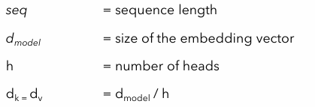
Multi-Head Attention
Similar to self attention
Use specific number of head instead of full q, k, v
Parameters used in Multi-head Attention

Slide 14
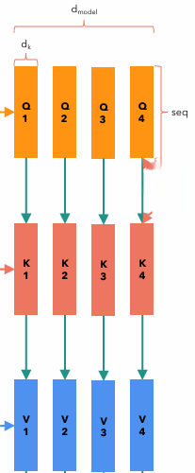
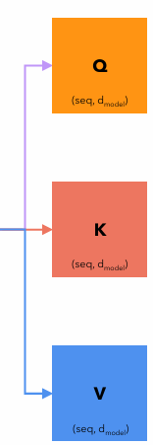
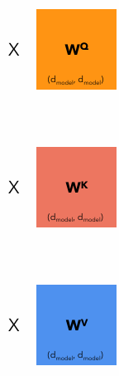
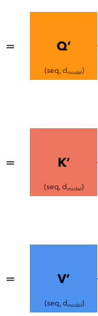
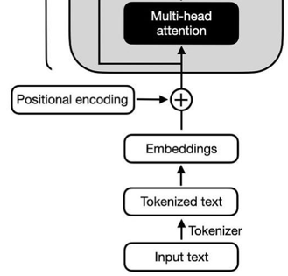
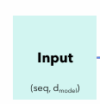
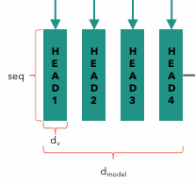
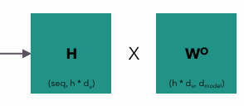
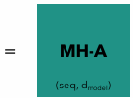
Multi Head Attention
Now we have completed….
Attention Formula applied here

Slide 15
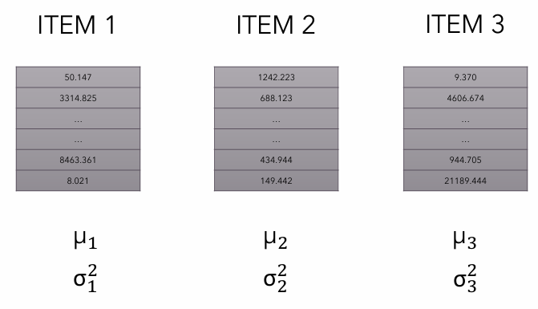


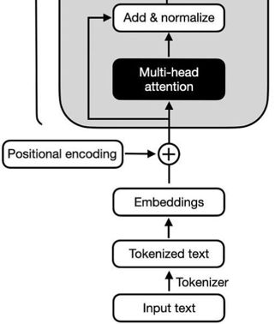
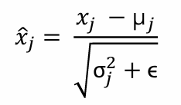
Layer Normalization
Makes the values stabilize and standardized
Here,
= Mean
= standard deviation
= Very small value(10^-6)
Now we are almost finished….

Slide 16

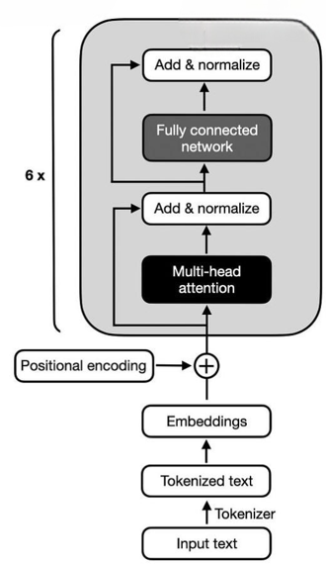
Final Stage
Feed Forward Network
Add a dropout layer(reduce overfitting) and pass it through relu
Residual Connection
Add and Normalization at same time
Finally we got output encoder block
(batch_size, seq_len, d_model)

Slide 17
Conclusion
Overcomes positional dependency using positional encoding
Creates relationships between words with multi-head attention
Encoder based model: BERT, RoBERTa, ELECTRA
Encoder-only models lack generative capabilities
A decoder is needed for text generation

Slide 18
References
https://www.oreilly.com/library/view/natural-language-processing/9781098136789/
https://medium.com/@sayedebad.777/building-a-transformer-from-scratch-a-step-by-step-guide-a3df0aeb7c9a
https://www.youtube.com/watch?v=bCz4OMemCcA&t=1383s

